Slide 1
Microsoft Learn ILT course content master template
REMOVE SECTION BEFORE PUBLISHING
Microsoft Learn branded PowerPoint presentation template for ILT courses
June 2023
Microsoft confidential

Slide 2
How to use the new Microsoft Learn ILT course PowerPoint template Follow these tips to help transition slides to this template from previous designs.
Delete these slides before distribution. They are intended only for guidance.
TIP 1
Copying content
TIP 2
Apply a master to your slides
TIP 3
Icons and illustration
When inserting content into the new template from another deck, copy the slide(s) and choose “Use Destination Theme” when pasting. This is the safest way to ensure you’re not creating extra masters (and bloating the file size).
After pasting, you may need to adjust the formatting to fit the new template's layout. Pay attention to font sizes, line spacing, alignment, and any other formatting elements that may need fine-tuning.
To apply a master layout to a slide, click Home > Layout and choose from the available options. If the copied content doesn't fit correctly into the new placeholders, you may need to copy and paste the content into the corresponding placeholders manually.
If you’ve removed or made changes to placeholders on a slide and want to restore it, go to the Home tab, navigate to the Slides group, and select Reset.
Use icons sparingly as visual cues or to break up large amounts of text. This template provides a limited number of branded icons for commonly used slides such as Summary, Knowledge Check, and Labs. A simple set of icons is available at the end of this deck, with links to the full Monoline icon set on Brand Central. For additional resources, please refer to the last page of this deck.

Slide 3
⚙️ Model selection
model.name: gpt-4
model.version: 0613
tokens.used: 1,452
response.raw: {...}
response.cleaned: true
success: true
💰 Cost (token usage)
🧹 Cleaning needed?
✅ Is output valid?

Slide 4
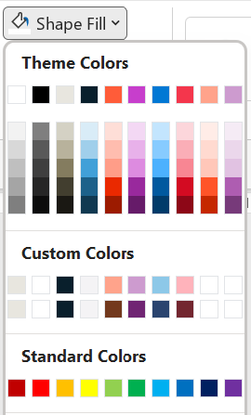
Delete these slides before distribution. They are intended only for guidance.
Slide palette info
The PowerPoint palette for this template has been built for you and is shown below.
Avoid using too many colors in your presentation.
PowerPoint Theme Accent colors
Microsoft Learn theme color palette
Limit usage of tints and tones that PowerPoint automatically generates. Instead, use the light and dark custom colors below.
Accent 1
Accent 2
Accent 3
Accent 4
Accent 5
Accent 6
Microsoft Learn custom colors (light and dark)
Use Accent 1-2 as the main accent colors.
Use Accent 3-4 when additional colors are needed.
Use Accents 5-6 sparingly.
Do not use: Standard Colors

Slide 5
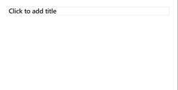
Delete these slides before distribution. They are intended only for guidance.
Ensure slide content is accessible
Take the following steps to create content that everyone can consume effectively.
Contrast
Use high contrast colors for maximum readability. The recommended contrast is 4.5:1.
Download the Color Contrast Analyzer to determine the legibility of text and the contrast of visual elements
Shape and color
Use different shapes with a legend to indicate statuses to accommodate for color blindness. Example:
Alt text
Alt text helps people with screen readers understand the content of slides. You should create alternate text for shapes, pictures, charts, tables, SmartArt graphics, or other objects. Here’s how:
Right click on item
Select Edit Alt Text
Enter a Description
If an object is meant to add visual styling and doesn’t contain meaning, do not add alt text and instead check Mark as decorative
Slide layouts
Using built-in slide layout that matches your content ensures a hierarchical reading order of text blocks. Example: If a new slide will have a title, rather than starting with a blank layout and adding a text block for the title, choose one of the built-in layouts with a title placeholder.
Reading order
Screen readers describe content on the screen in the order it was created. To ensure your content is read back in the order you prefer, arrange your objects in the Selection Pane appropriately. Objects on the bottom of the selection pane are read first. Here’s how:
Click Home tab
In the Drawing group, select the Arrange drop-down menu
Click Selection Pane
Additional tips
Be sure to run the Accessibility Checker:
Go to File
Click the Check for Issues drop down menu
Click Check Accessibility
Videos need to be accessible: if your presentation includes a video, ensure it is captioned and audio described (if appropriate) Visit the Office Accessibility Center to learn more about accessibility in PowerPoint.
Text
Text
Text
Subject 1
Subject 2
Subject 3
C1
C2
C3

Slide 6
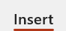
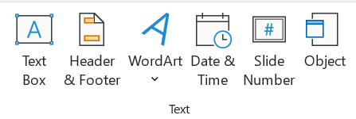
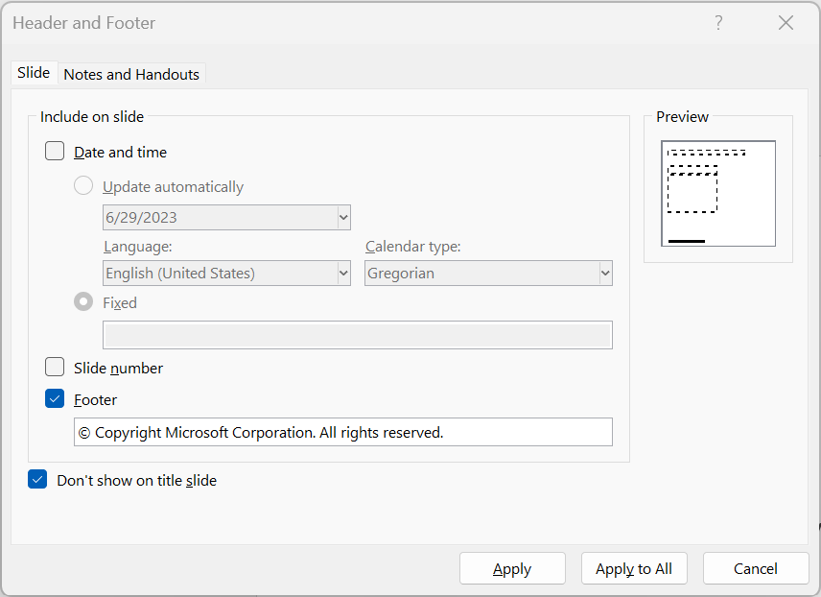
Footer
Delete these slides before distribution. They are intended only for guidance.
1
2
How to edit footer copy
The template includes “© Copyright Microsoft Corporation. All rights reserved.” in the footer by default. Follow these steps to edit or remove this copy.
To change the footer
Go to the Insert tab
Select Header & Footer
Check the footer box
Type “Your copy” into the accompanying box
Select Apply or Apply all
3
4
The footer will appear on the slide surface
5

Slide 7

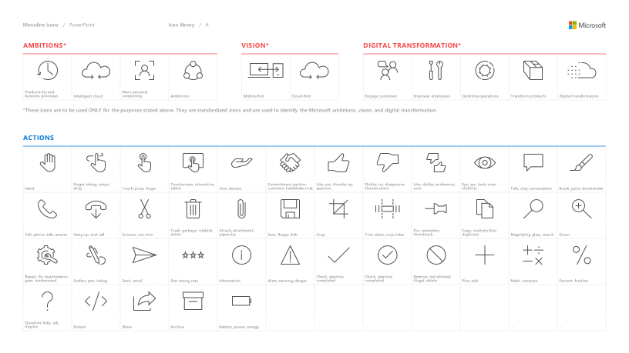
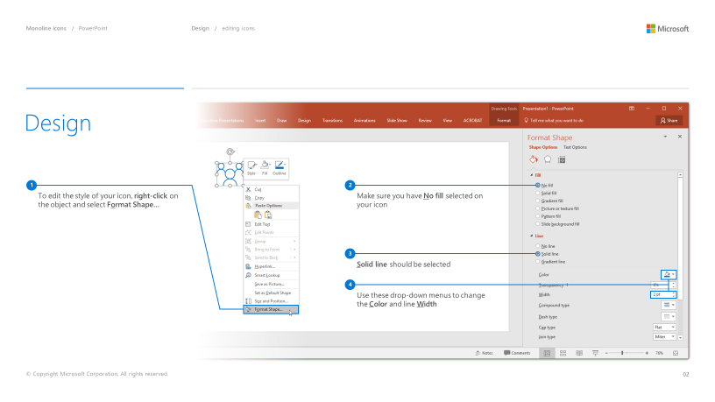
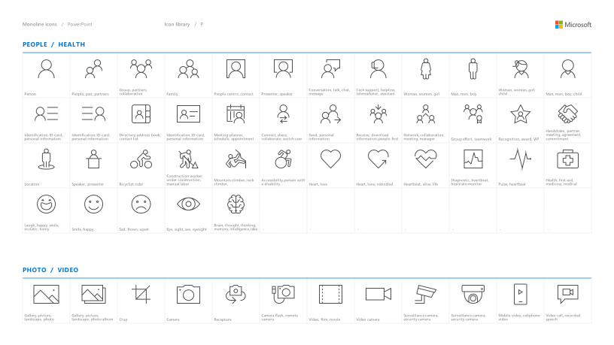
Microsoft monoline icons
Delete these slides before distribution. They are intended only for guidance.
Looking for icon resources?
The Monoline icon library for PowerPoint is a slide deck that provides a library of icons for use in PowerPoint presentations.
The Monoline icon style guide for PowerPoint is a pdf with additional guidelines.
Download both from Brand Central.

Slide 8
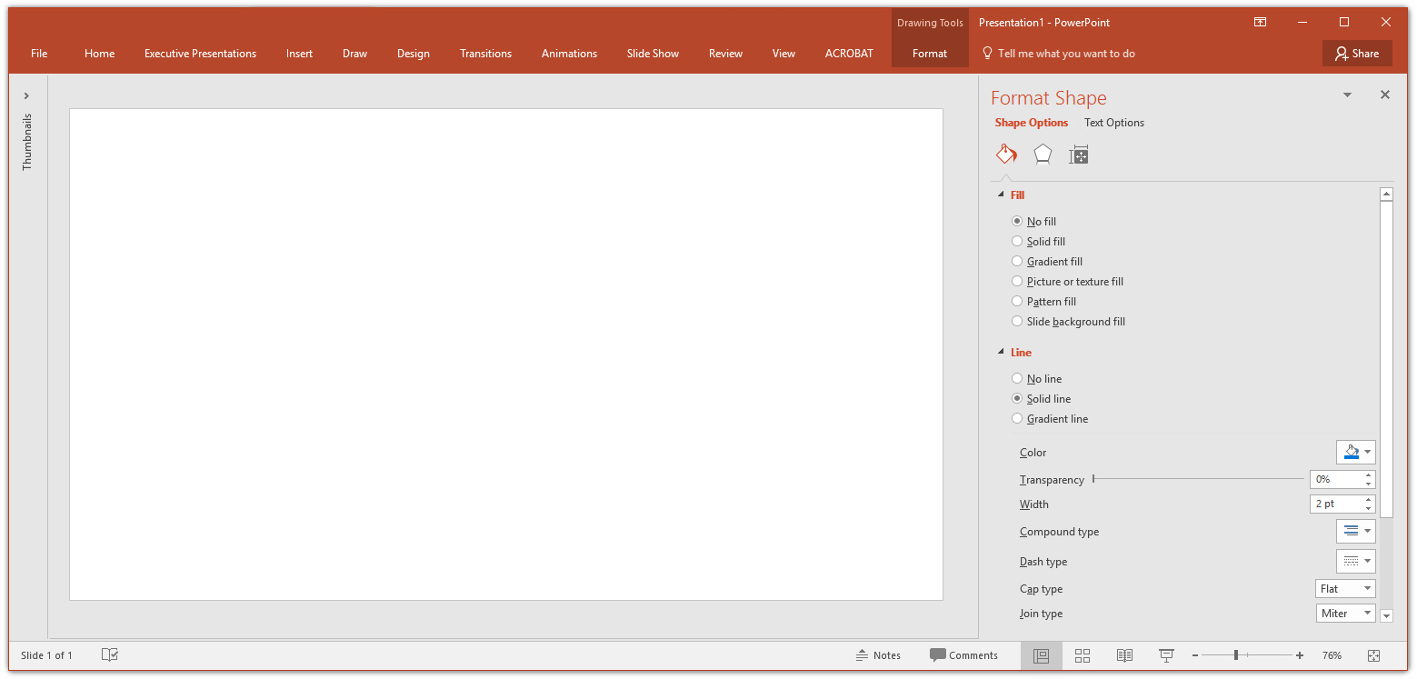
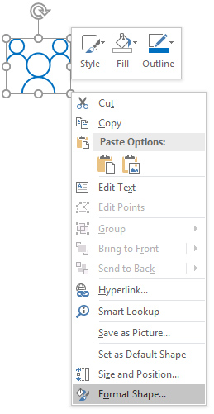
Line weight and sizing
Delete these slides before distribution. They are intended only for guidance.
The size of an icon is dictated by its largest dimension. For example: if an icon is 0.43” tall, and 0.35” wide, the line weight should be 1.25 pt. Each icon should be no thinner than 1.25 pt., and no thicker than 1.75 pt. line weight. Additionally, an icon typically shouldn’t be larger than 1” or smaller than 0.25”.
Download the style guide from Brand Central for additional guidance.
2
Make sure you have No fill selected on your icon
3
Solid line should be selected
1
To edit the style of your icon, right-click on the object and select Format Shape…
4
Use these drop-down menus to change the Color and line Width

Slide 9
Glossary
Add a key term | Insert an explanation of what this term represents, providing a brief overview of the concept.
Add a key term | Insert an explanation of what this term represents, providing a brief overview of the concept.
Add a key term | Insert an explanation of what this term represents, providing a brief overview of the concept.
Add a key term | Insert an explanation of what this term represents, providing a brief overview of the concept.
Add a key term | Insert an explanation of what this term represents, providing a brief overview of the concept.

Slide 10
Icons should be primarily used as a visual aid, as a way to break up large amounts of text and content, or as a visual cue of the content that follows. Get the full set of icons for presentations
Delete these slides before distribution. They are intended only for guidance.
EXAMPLES FROM MONOLINE ICON LIBRARY
INDUSTRY SECTORS
Aeronautics | Agriculture | Architecture | Automotive | Construction | Education and research | Energy | Financial services | Healthcare | Engineering and manufacturing | Professional services, media | Sports
Government | Retail | Technology | Media and broadcasting | Travel and transportation | Education | Law | Science | - | - | - | -
MAPS / LOCATION
Globe, global, earth | Globe, global, earth | Navigation, GPS, POI, location, map | Map, location, GPS, directions, navigation | Navigation, GPS, POI, location, map | Map, location, route, quest, destination, journey | Download map, receive location | - | - | - | - | -
MONEY / FINANACE / RETAIL / CONSUMER
Shopping cart, store | Store, bag, shop | Money, dollar sign, cash, revenue, currency | Revenue, financial report, funds | Money, currency, coins | Bank, piggybank | Compare, balance, finance, justice | Credit card, payment, charge, debit card | Mobile payment, digital payment, e-commerce | Barcode scanner | Tag, sale, shopping | Bank

Slide 11
Get the full set of icons for presentations
Delete these slides before distribution. They are intended only for guidance.
EXAMPLES FROM MONOLINE ICON LIBRARY
OBJECTS / TOOLS
Alarm clock | Hourglass, timer | Clock | Flashlight | Funnel | Calculator | Binoculars | Scissors | Camera | Battery, power, charge | Magnifying glass | Tools, screwdriver, wrench
Paperclip | Pushpin, thumbtack | Key | Lock | Safe | Piggybank | Bag | Ballot box, drop box | Box, archive, storage | Present, giftbox | Box, package, shipping | Briefcase, business, work, job
Books, reading | Book, dictionary, novel | Notebook, journal | Pencil | Paintbrush | Paint palette, color | 3D, hologram | Trophy, award | Ribbon, award, reward, accomplishment | Ribbon, award, reward, accomplishment | Flag, finish line | Flags, finish line, win, race
Open door, entryway, opportunity | Clipboard | Megaphone, speaker, speech, announcement | Microphone | CD, music album | Headphones | Headset | Eye glasses | Bike, bicycle | Umbrella, bumbershoot | Balloon, party, celebration | Rocking chair
Remote control | Robotic, manufacturing, mechanical, automation | Forklift | Gears | Traffic cone, construction | Flask, chemistry, science, beaker | Maze, puzzle | Target, bullseye, aim, arrow, dartboard, darts, archery | Games, strategy, chess, poker | Musical instrument, drums | Pizza, food | Lightbulb

Slide 12
Quick links
Below are some useful quick links.
Delete these slides before distribution. They are intended only for guidance.
Microsoft Learn Brand Guidelines >
Microsoft content style guides >
CELA Self-Service Tool >
Accessibility assessment tool
To download photography and other assets, visit Brand Central >

